Slide 1
Project 3
Screenshots Attached
SimpliLearn IAM User: simplilearnvakalapudibhavyasrikanthivakalapudibhavyasrikanthi
V. Bhavya Sri kanthi
University Id: 170031338

Slide 2
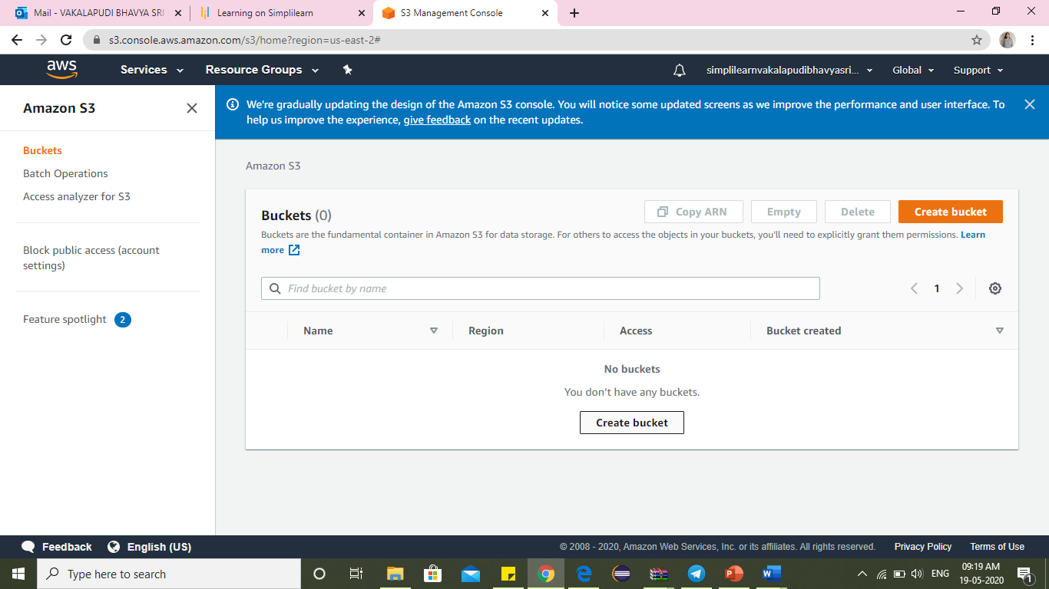
Creating bucket in Amazon S3 bucket

Slide 3
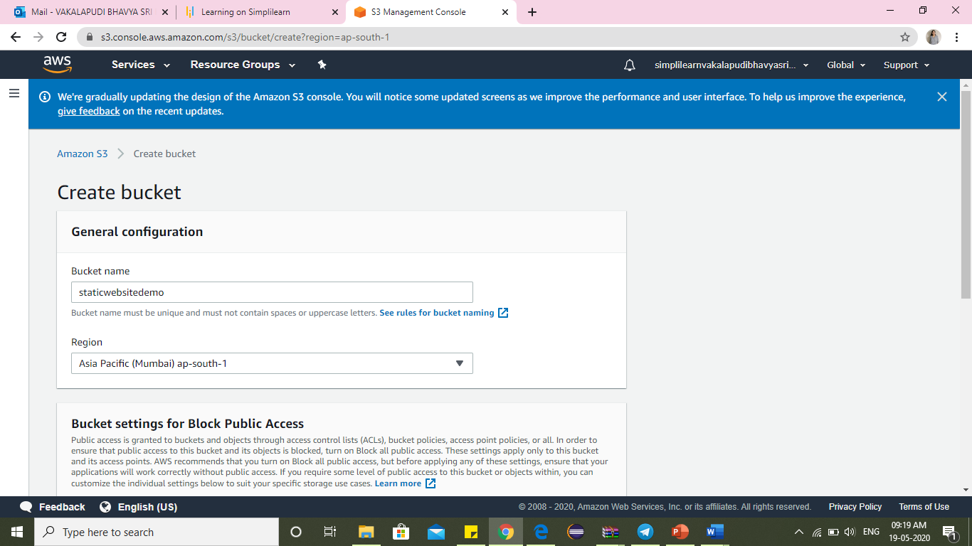
Name your bucket and choose region

Slide 4
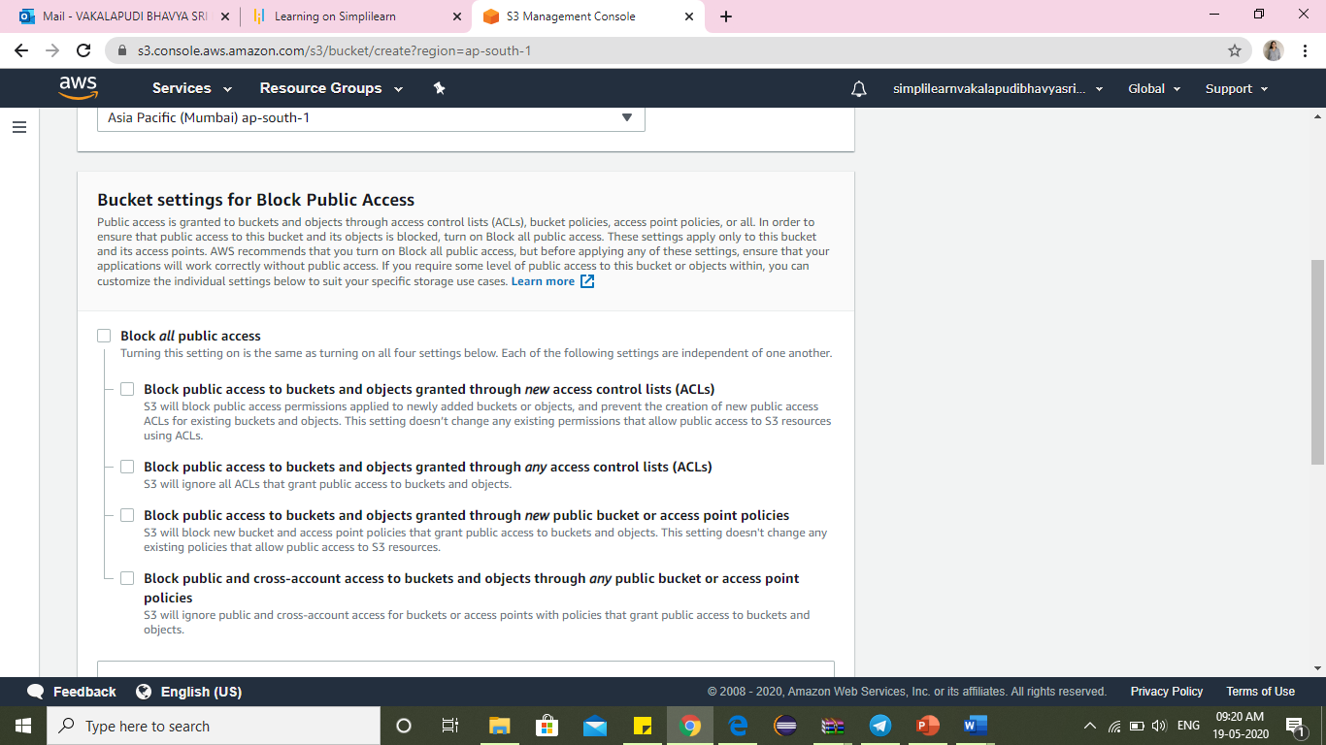
Uncheck ​Block all public access​, and click ​Next​.

Slide 5
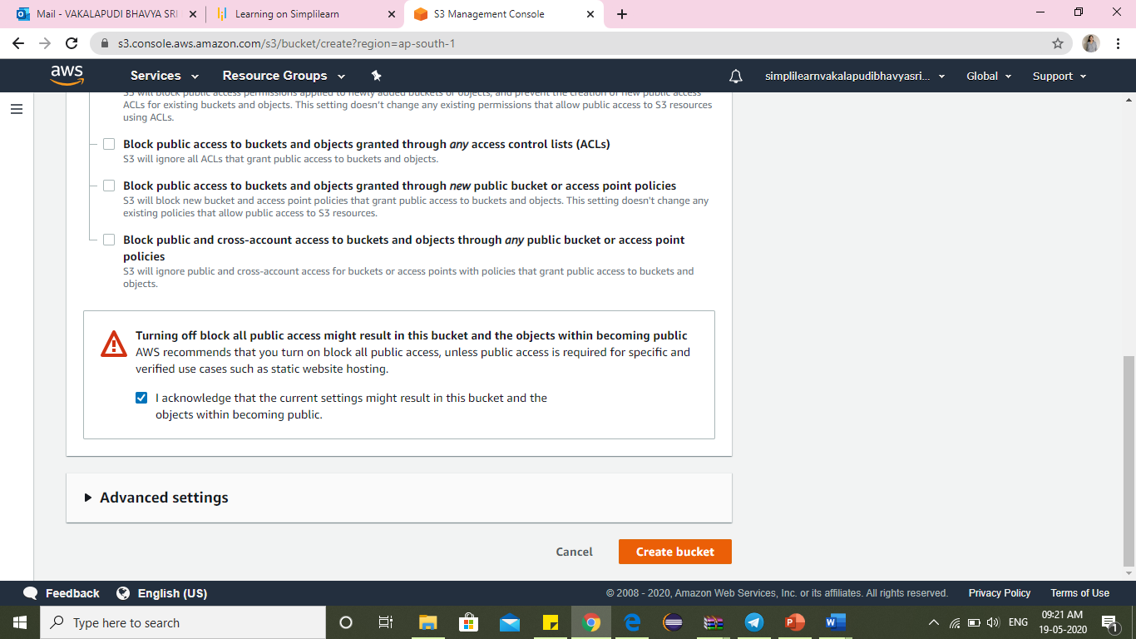
Click create bucket

Slide 6
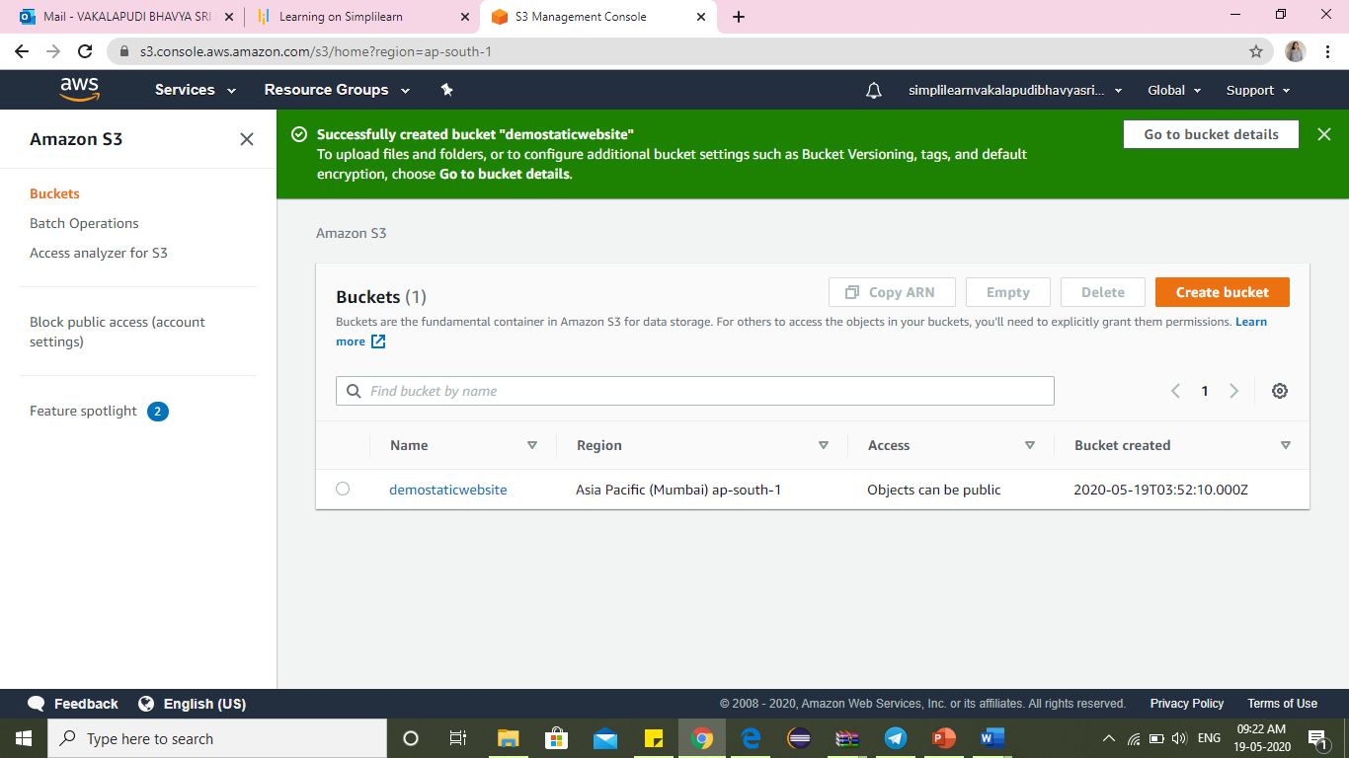
Click on the bucket name

Slide 7
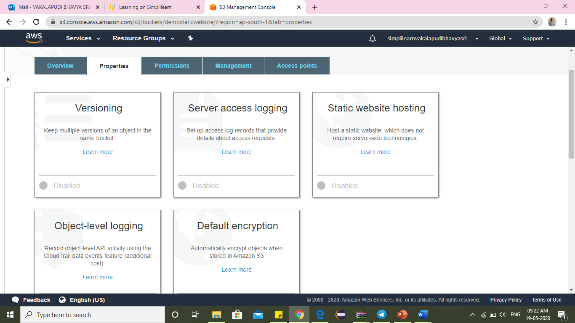
Go to static website hosting within properties

Slide 8
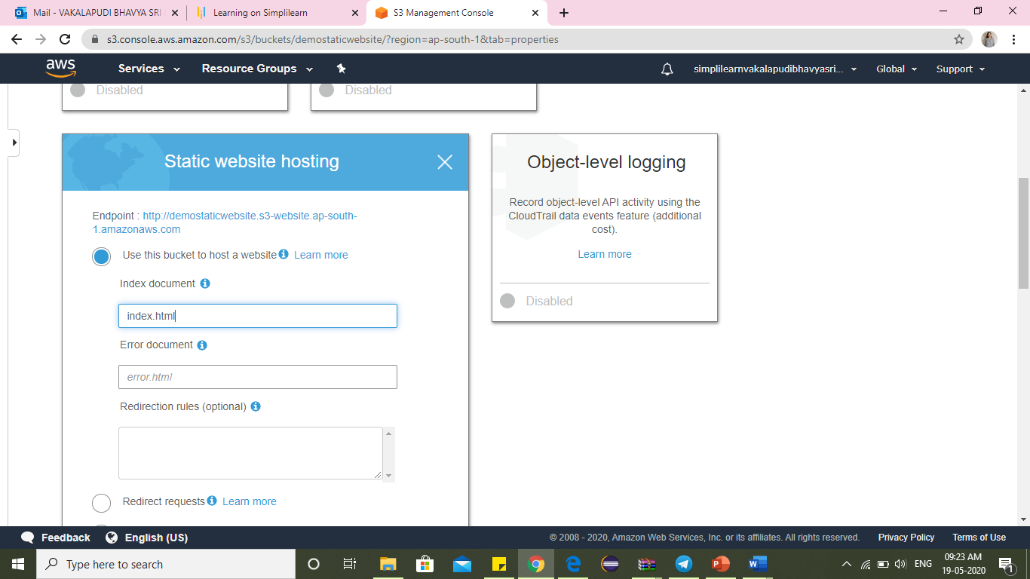
Use this bucket to host a website

Slide 9
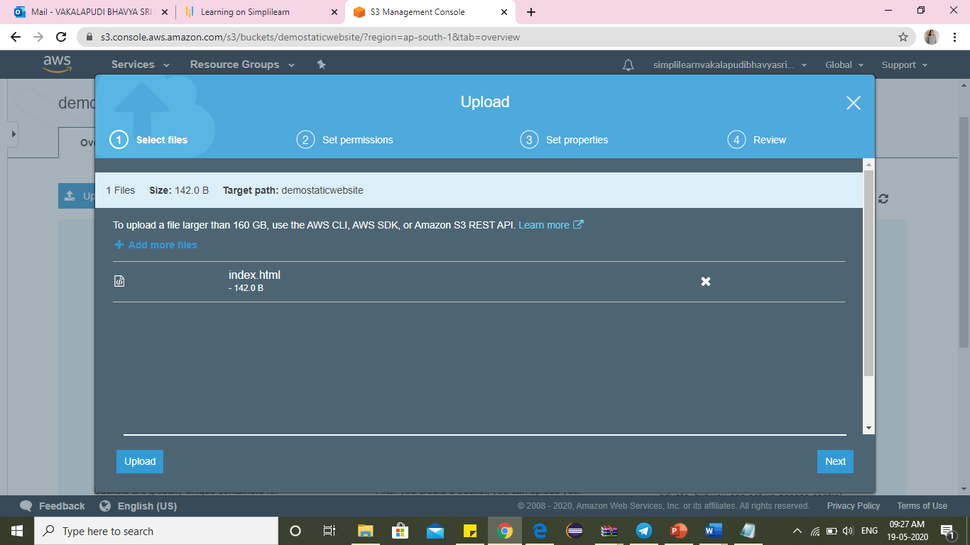
Upload html file

Slide 10
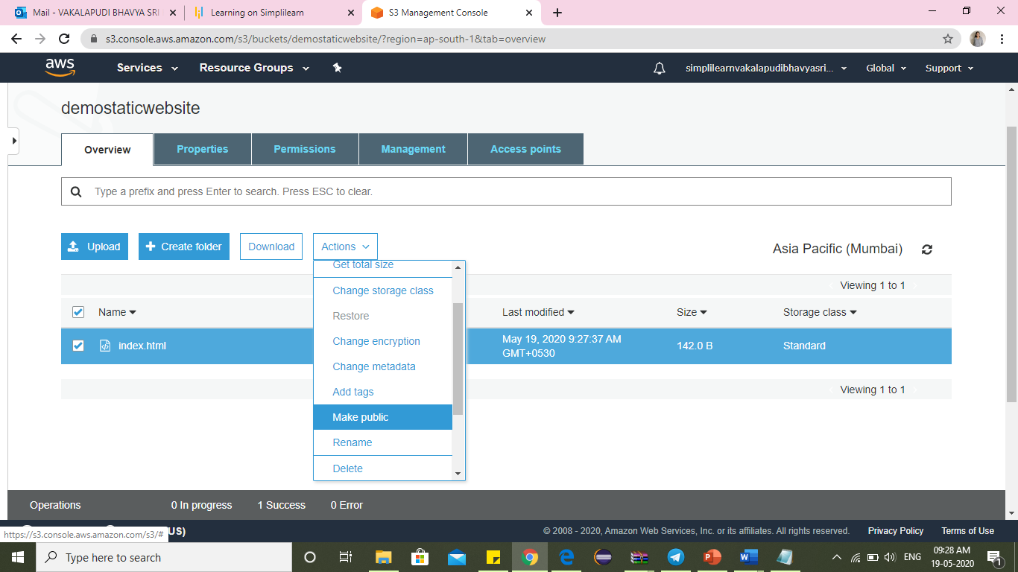
Make the uploaded file as public

Slide 11
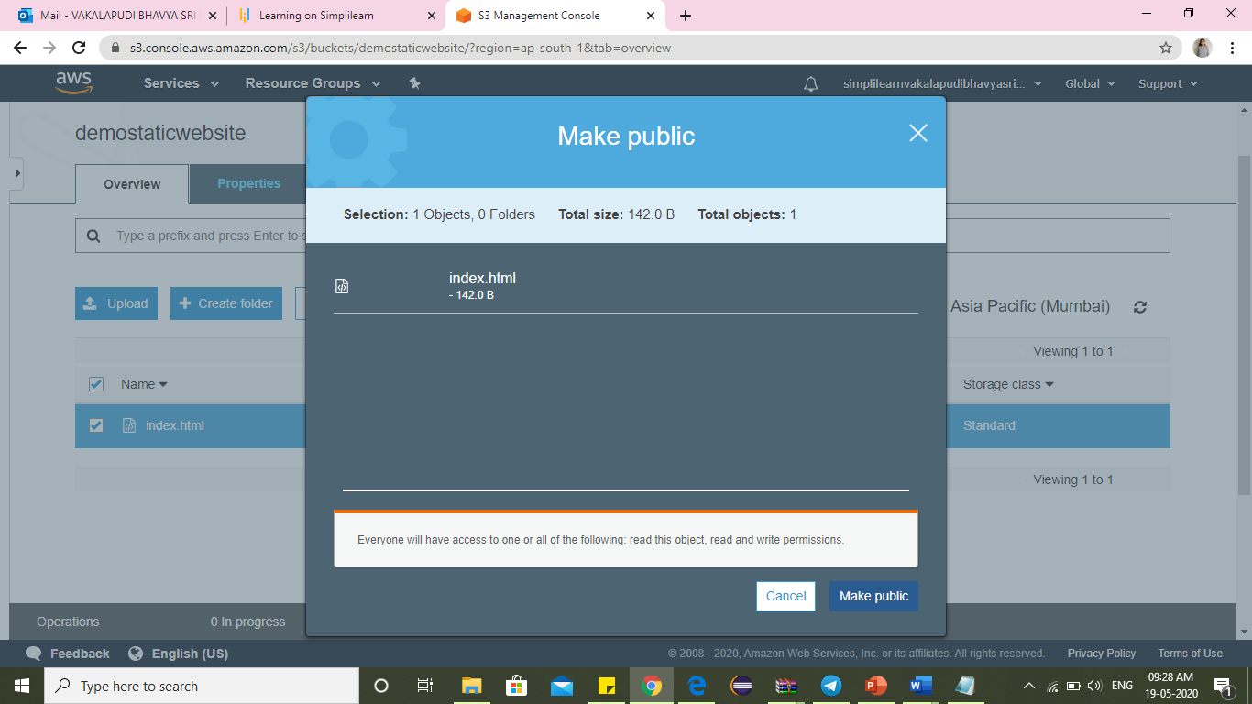
Click on make public

Slide 12
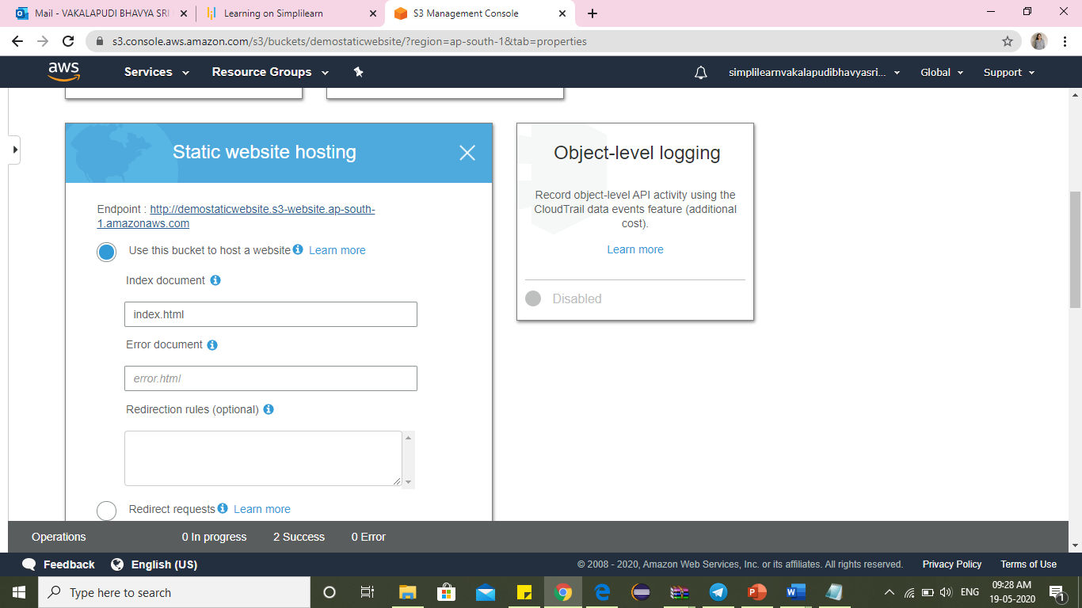
Go to Properties -> Static Website Hosting and click on the ​Endpoint​.

Slide 13
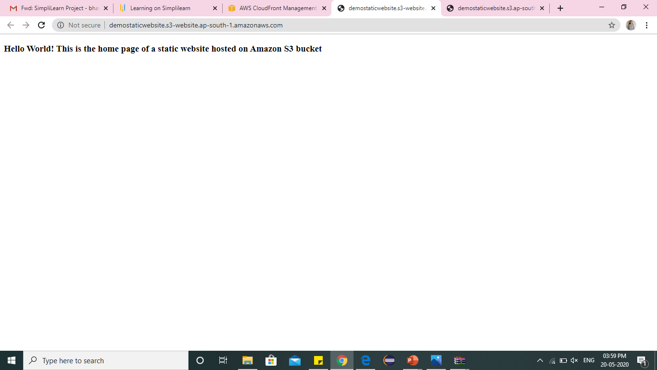
You can access the index.html page

Slide 14
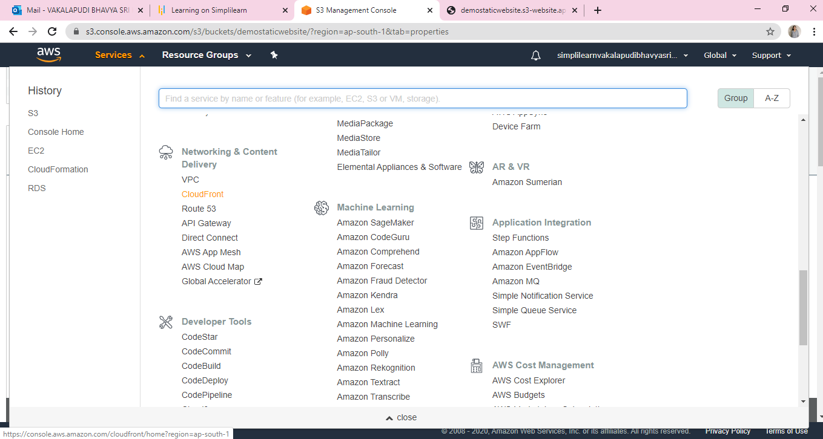
Go to CloudFront

Slide 15
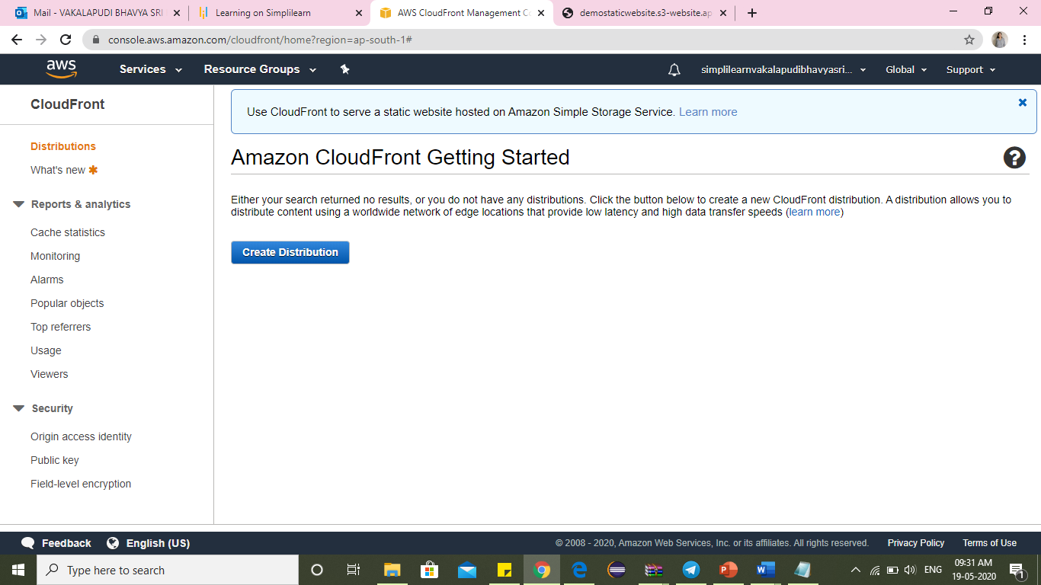
Click Create Distribution

Slide 16
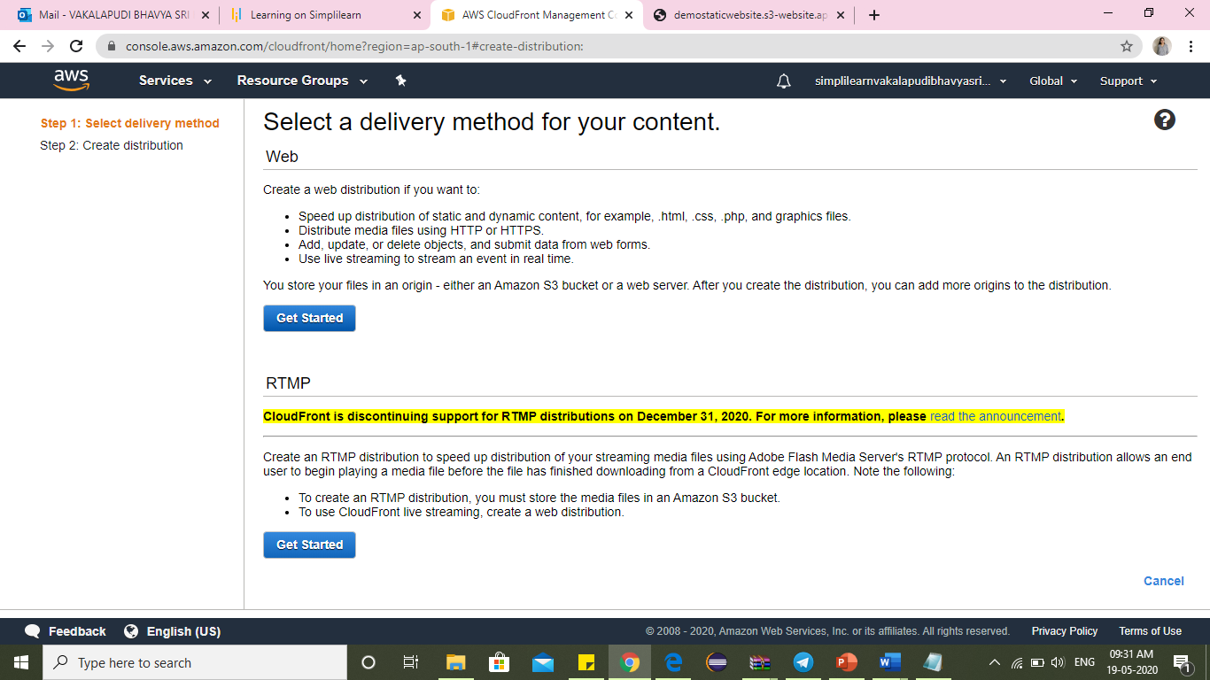
Click on Get Started for web delivery method

Slide 17
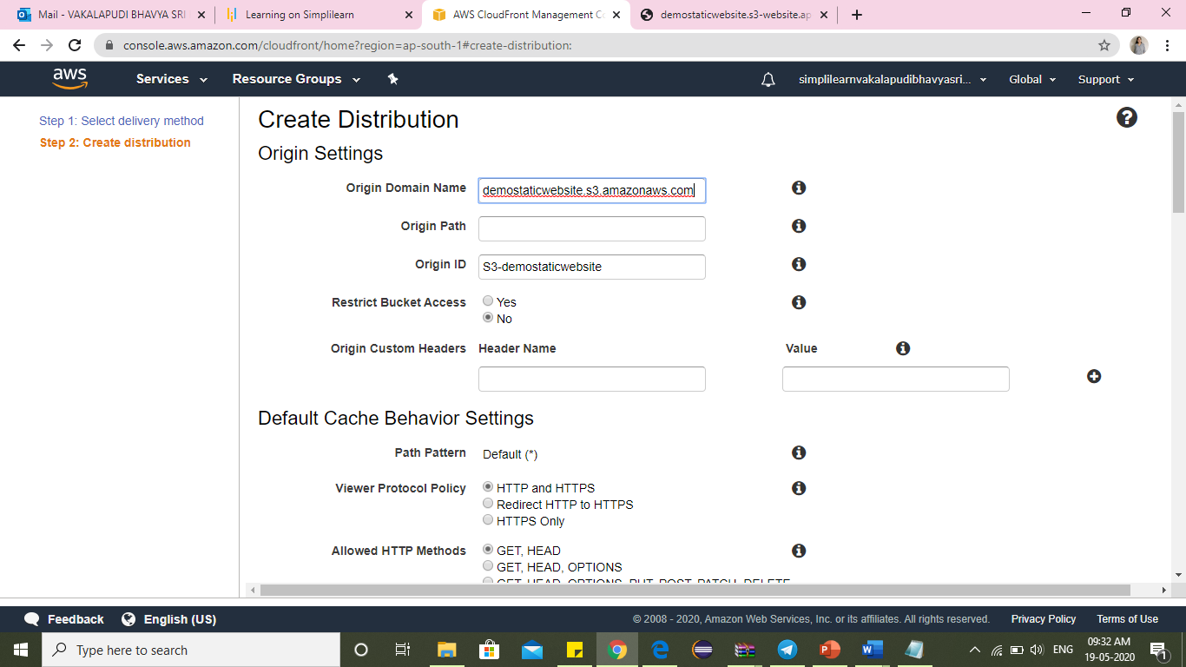
Choose S3 bucket for origin domain name

Slide 18
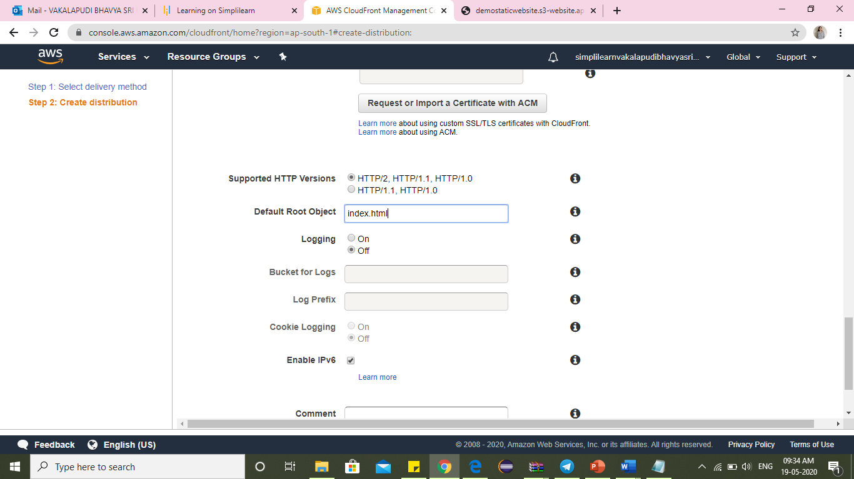
For Default Root Object and type html file

Slide 19
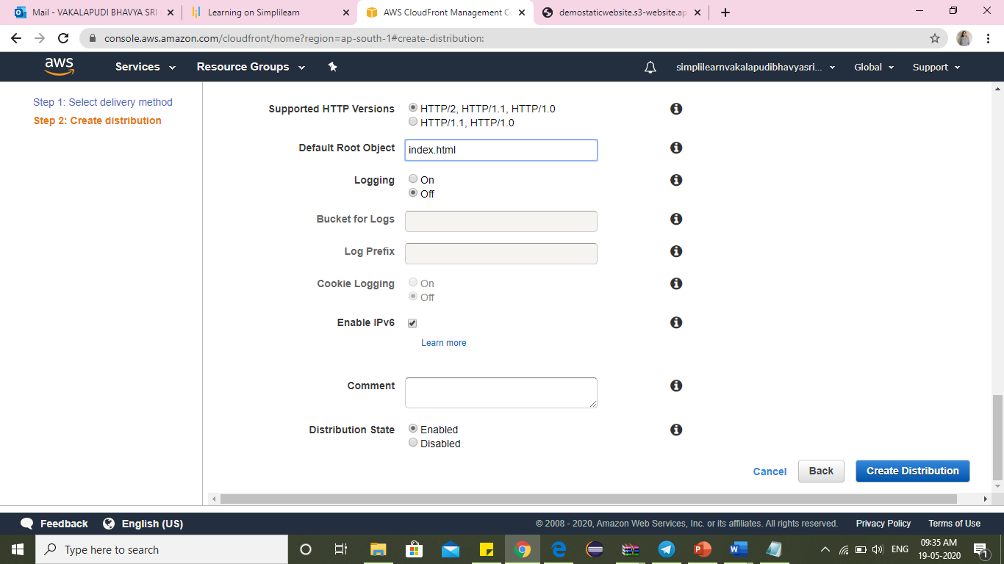
Click Create Distribution

Slide 20
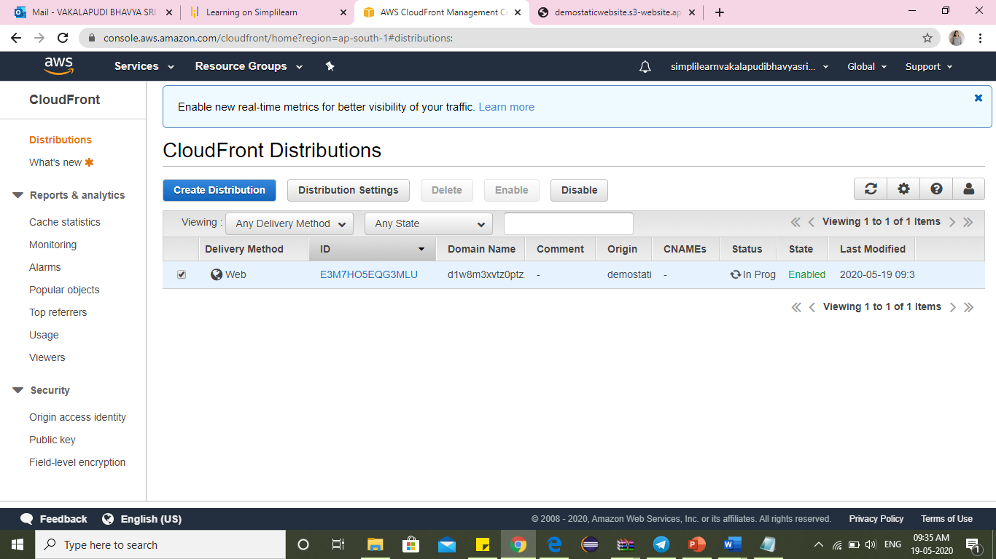
Select your distribution-> Distribution Settings

Slide 21
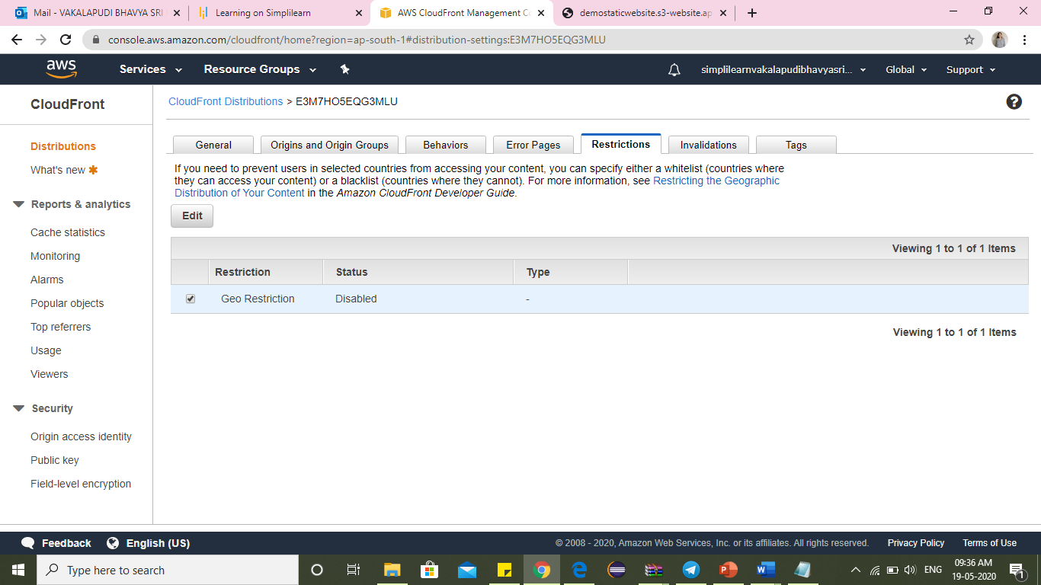
Go to Restrictions and click Edit

Slide 22
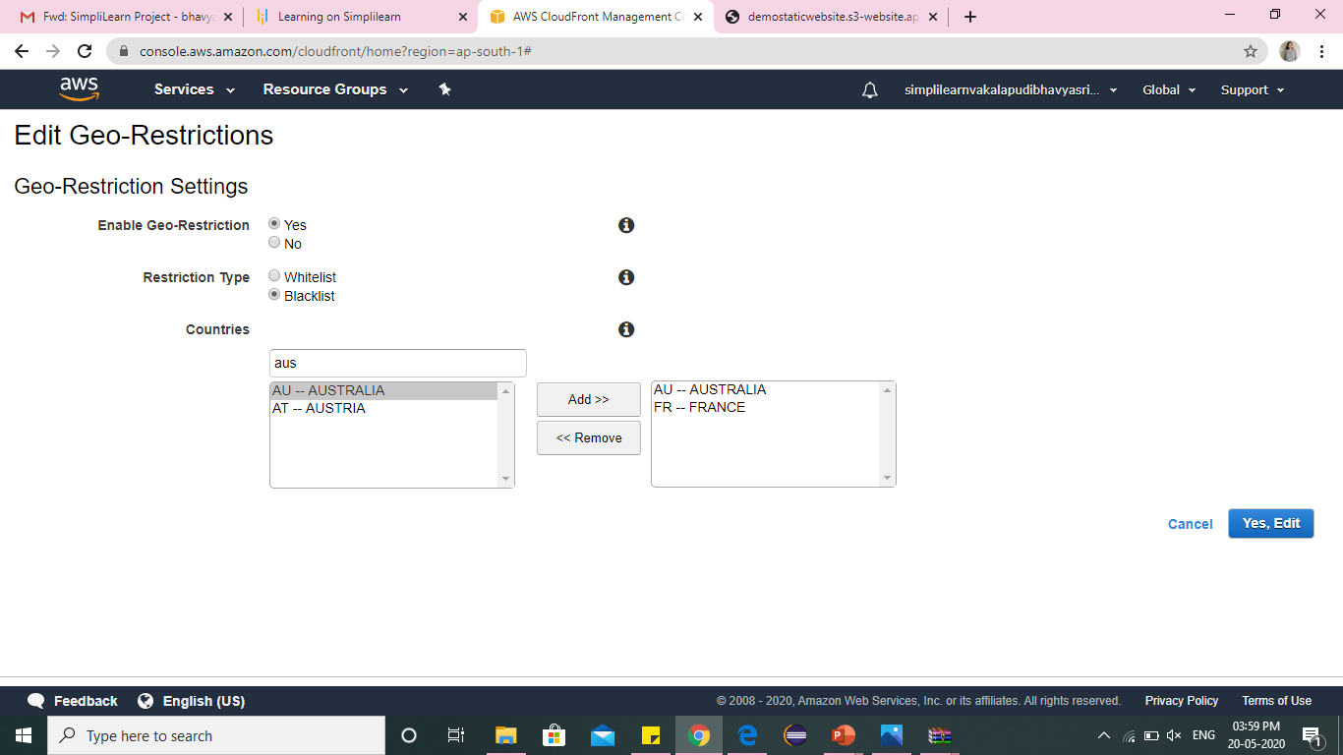
Blacklist France and Australia

Slide 23
Click on Yes, Edit

Slide 24
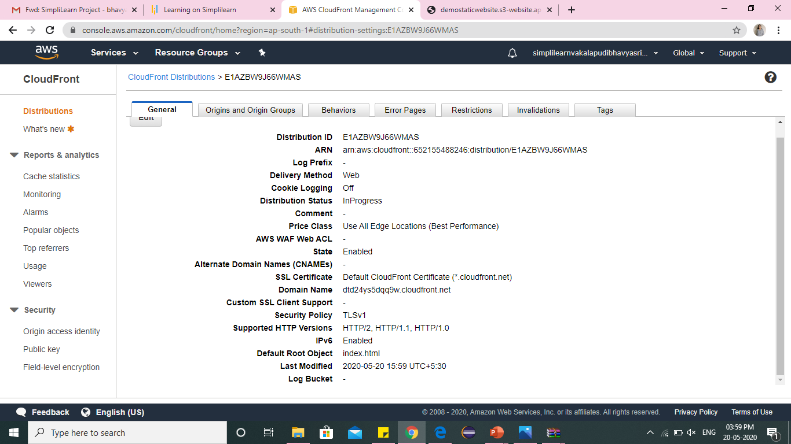
Go to General and copy Domain Name

Slide 25
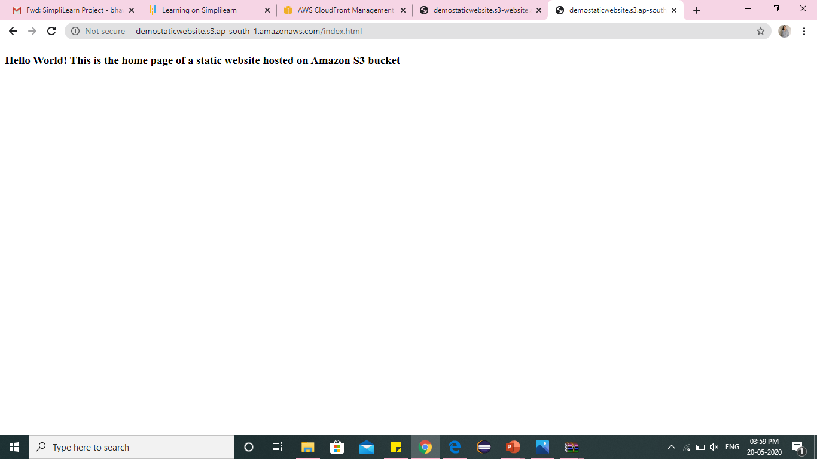
Access your website using the same domain name

Slide 26


